Slide 1






Slide 2
Top Facts-Healthcare Workforce in Ohio
Ohio employs more than 777,000 healthcare employees, a rate that is estimated to grow 0.3 percent annually
Among the 777,000 total healthcare jobs in Ohio, more than 646,000 (83%) of those employed incumbents are in clinical healthcare
As of November 2024, there are nearly 67,000 active job postings for healthcare workers in Ohio
Ohio employs nearly 137,000 total registered nurses (RN). As of November 2024, there are more than 15,000 (22.3%) active job postings for RNs in Ohio
Healthcare’s total economic impact is $171 billion, which makes it the third largest industry in Ohio in total economic impact

Slide 3
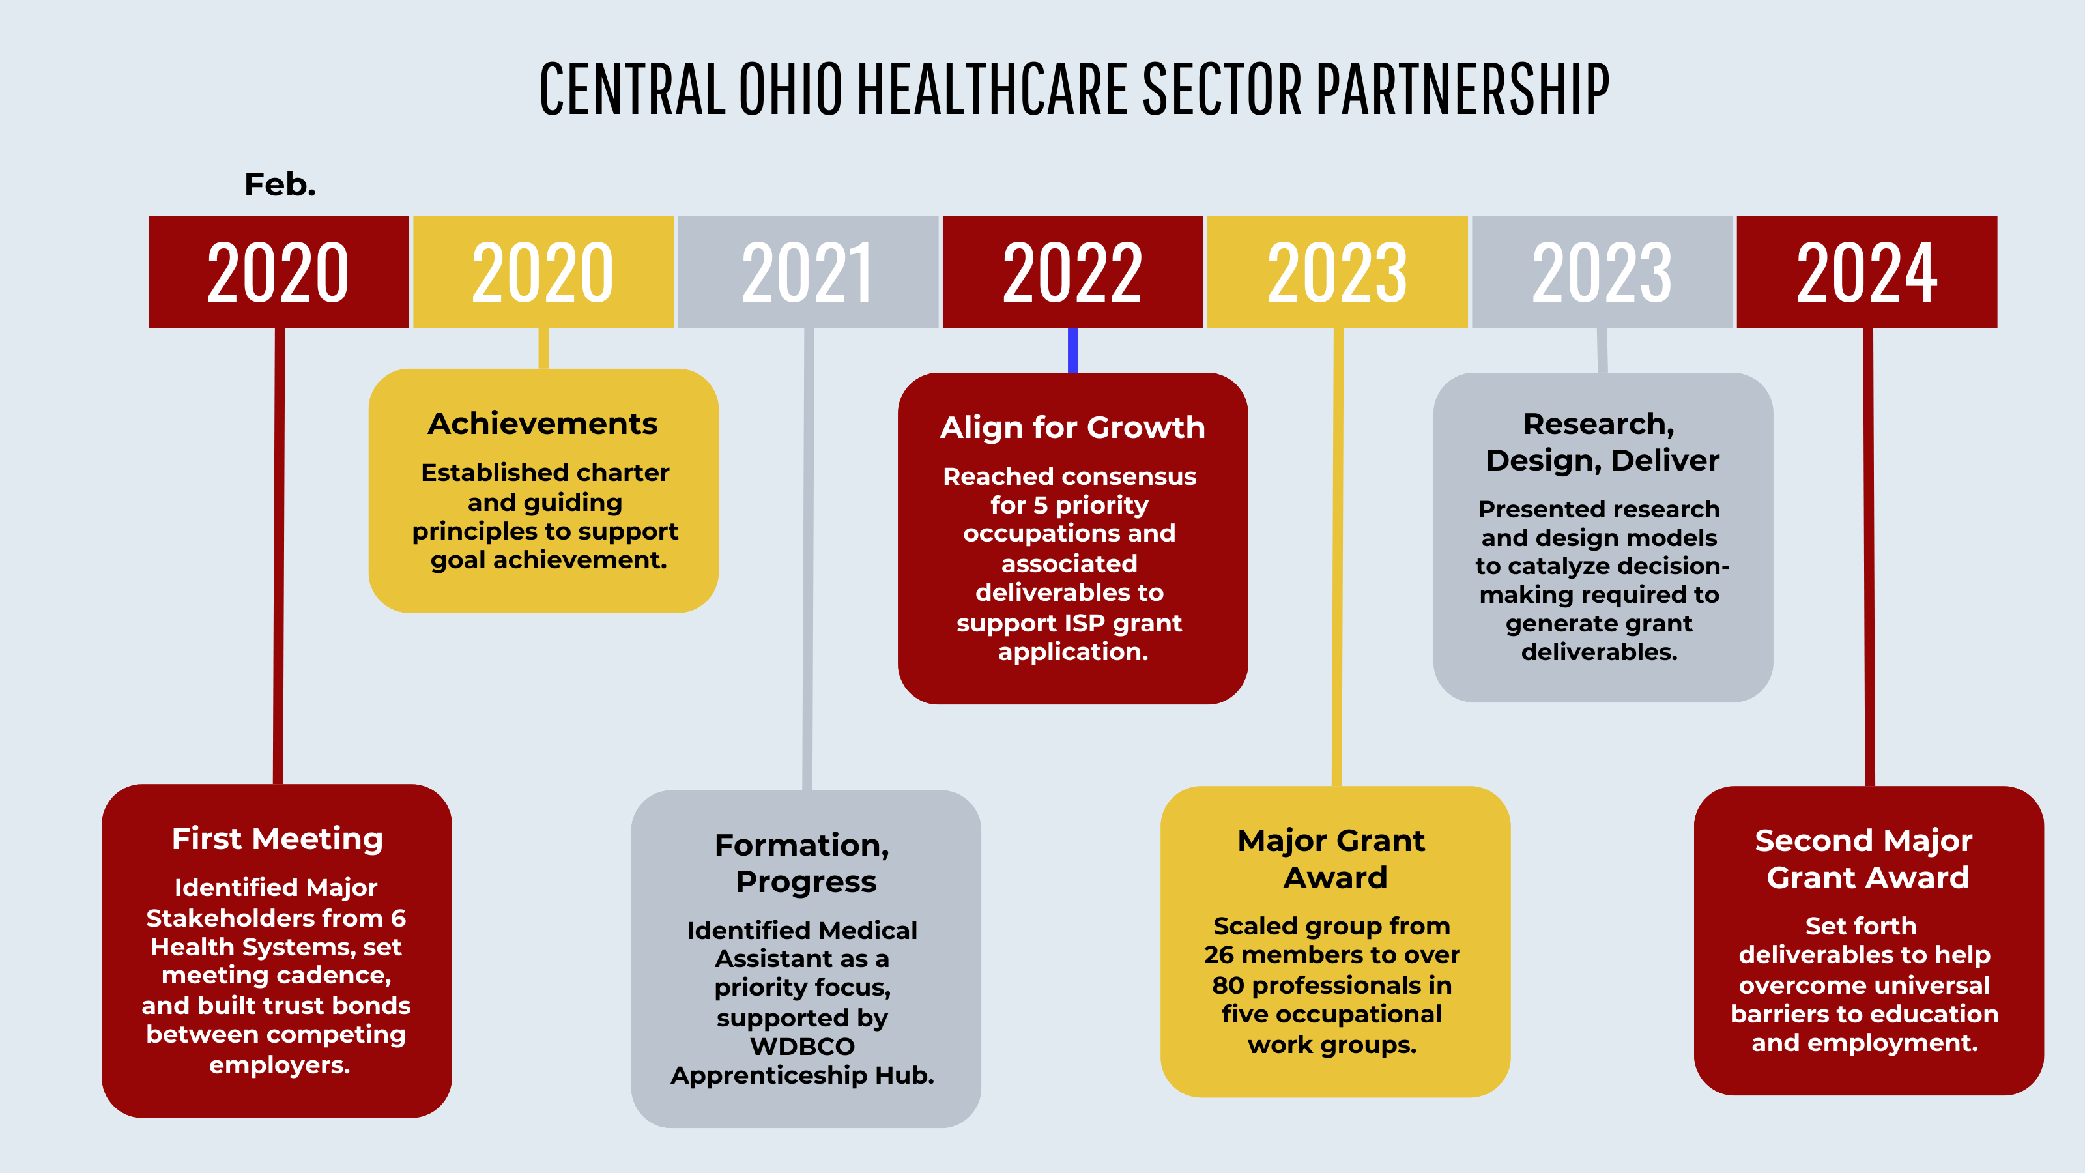

Slide 4
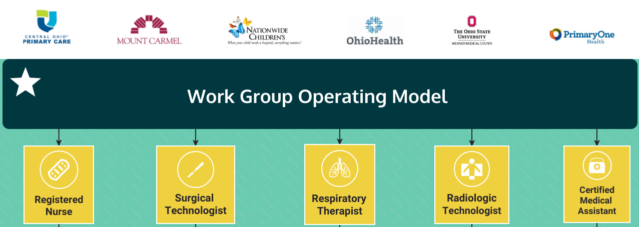

Slide 5
2023-24 Objectives | 2024-25 Objectives
Create a Career Awareness Campaign | Strategically Market the Healthcare ISP and its Priority Careers Website, Distribution Channels, Social Media HCCOCO Hands-On Event Retention and Recruitment Best Practices – Education and Workforce
Promote and Influence Expansion of Education Opportunities | Host Quarterly Regional Clinical Coordination Meetings with Educators Influence Degree, Certificate Programs Understand demand / supply of program growth in the region
Identify RN Pathways for Students to Earn Accreditation | Address Barriers to Education and Employment Create Career Navigation Standards to Provide Point-of-Entry Post-HS Support Support Waitlisted Students, Compel Growing Cohorts at Reputable Institutions Coalesce Support for Creating HCCOCO Cohorts (Med Lab Tech, RT, GXMO)
Promote and Influence New Candidates for Clinical Occupations | Enhance Educational Readiness of Students Interested in HC Roles Promote Informal Learning Experiences Showcase Activities Tailored by School Level Teacher, Counselor HC Career Guides

Slide 6
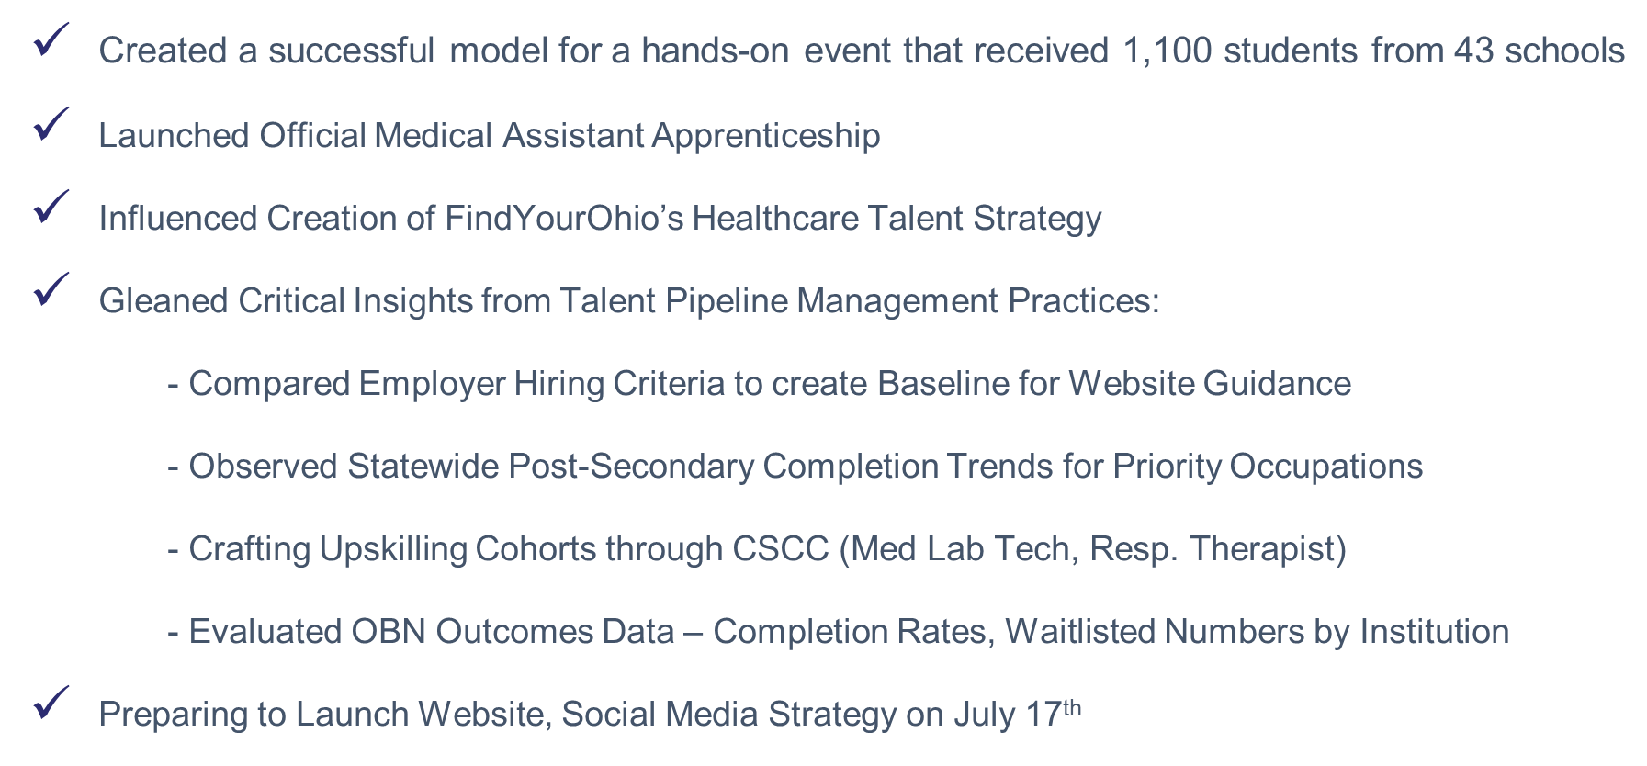

Slide 7

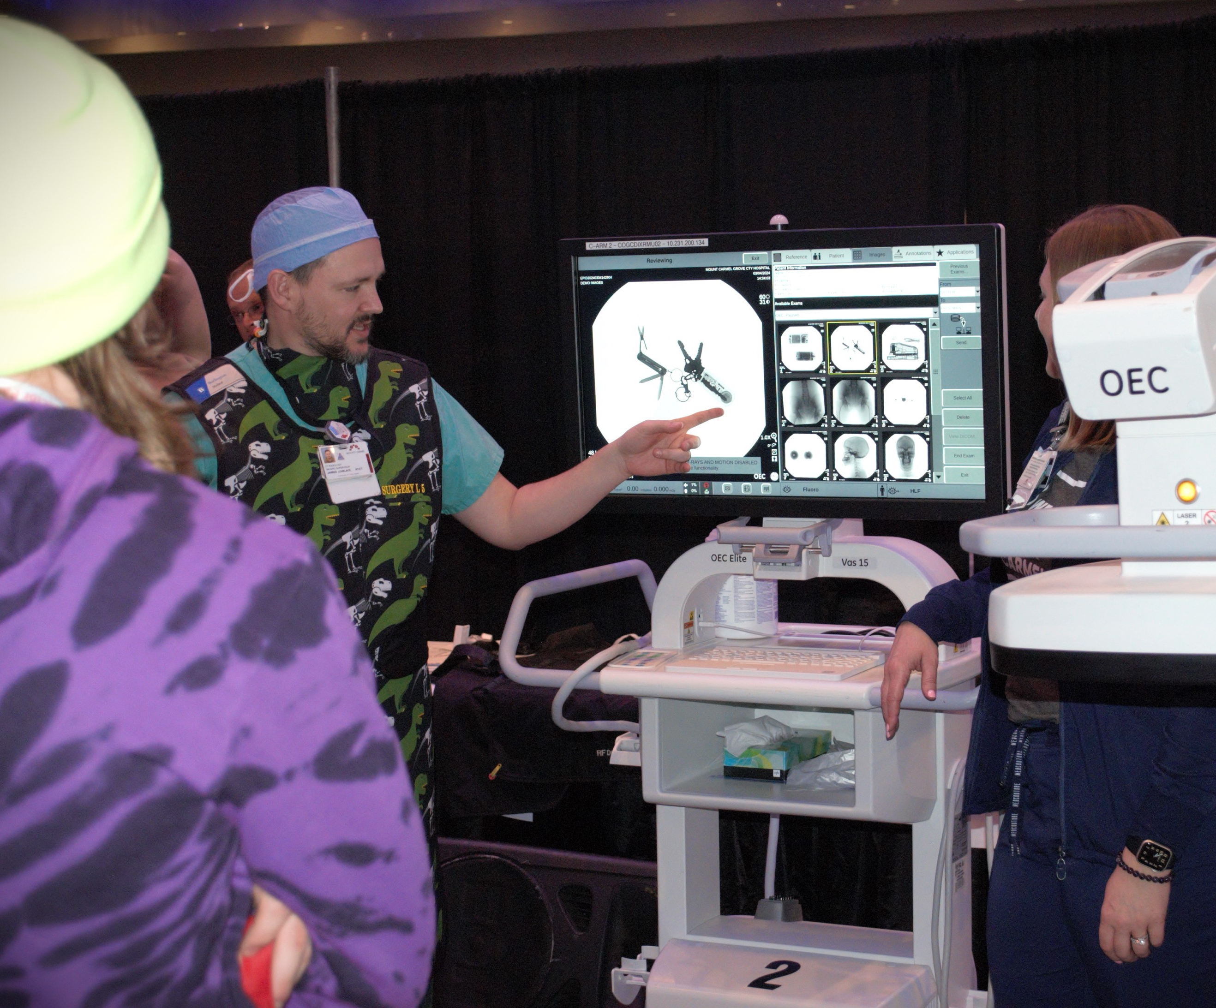




Slide 8

healthcarecareersohio.org

